Slide 1
Assumptions of regression Model
Murthi

Slide 2
Assumptions of Regression model
Assumption 1: Linear model
The mean value of y, for each value of x, is given by the linear regression
i.e., The expected value of the random error e, E(e) = 0
Assumption 2: Constant variance (homo_scedasticity)
For each value of x, the values of y are distributed about their mean value, following probability distributions that all have the same variance

Slide 3
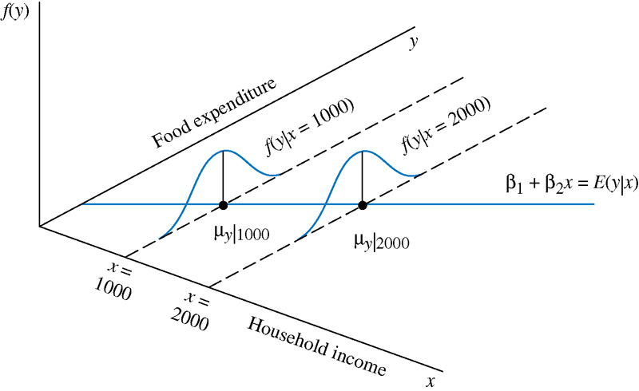

Slide 4
Assumptions continued..
Assumption 3: Autocorrelation
The sample values of y are all uncorrelated, and have zero covariance, implying that there is no linear association among them
Assumption 4:
The variable x is fixed (not random), and must take at least two different values
Assumption 5:
(optional) The values of y are normally distributed about their mean for each value of x

Slide 5
Properties of estimators
Unbiasedness = Mean(b) – β
An estimator is unbiased if the mean of the estimated parameter (b) is equal to the true parameter (β).
Efficiency
An estimator is efficient if for a given sample size, the variance of (b) is smaller than the variance of any other estimator.
Consistency – large sample property
As the sample gets infinitely larger, the estimator (b) converges to the true β.
Mean squared error = E(b-β)²
⁼ [bias(b)]² + Var(b)

Slide 6
Multicollinearity and heteroscedasticity affect efficiency but not unbiasedness and consistency of β. That is they affect the standard errors.
Therefore hypotheses tests will be incorrect and inferences will be prone to error.

Slide 7
Simple time series models
Predicting sales over time
S_{t} = a + b*t +c*t²+d* t³
Lagged effects of advertising
S_{t} = a + b* Ad_{t} + c* Ad_{t-1} + d* Ad_{t-2}

Slide 8
Analysis of Panel data
Murthi

Slide 9
Types of data
Cross sectional data – N observations 1 time period
Time series data – N small, T large
Panel data – N large, T small/large
Balanced panel – each CS has the same number of observations
Multiple year data for firms
Unbalanced panel – each CS may have different number of observations
Brand choice data for individual households

Slide 10
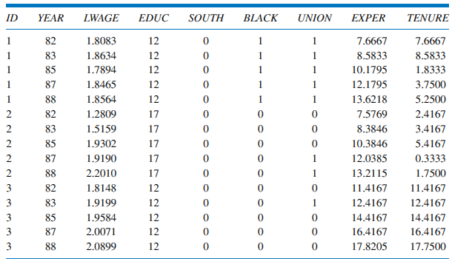
Panel data

Slide 11
Pooled Model
Pooled model is when you ignore panel structure and treat all observations as independent
Coefficients (β₁, β₂, β₃) are common to all i and t
Assumption 3 (no correlation between errors corresponding to the same individual) is now violated.
Variance is not constant over all observations.
Hypotheses tests not valid.
Bias in parameters – called Heterogeneity Bias

Slide 12
Heterogeneity
Main Idea: All cross sections (firms or individuals) are different from each other
Observed heterogeneity
- if we know and have data on a factor that is related to variation across customers/firms
OR
Unobserved heterogeneity
- when we know that they are different in unknown ways/unmeasured ways

Slide 13
Observed Heterogeneity
For instance, in OLS we assume β of price is constant over all persons. However, we know that some people are more price sensitive than others.
If price sensitivity is affected by Income, i.e., high income households are less price sensitive then we can model this as follows:
Sales = a + b Price
Let us assume b depends on income, or (b = c + d*Income)
Substituting we get
Sales = a + (c + d*Income)*Price = a + c*Price + d*Income*Price
So interaction terms can account for observed heterogeneity

Slide 14
Observed and Unobserved heterogeneity
If we believe heterogeneity is due to observed characteristics then we can include interaction terms in the regression model and interpret it accordingly.
However, if there are unobserved factors that affect heterogeneity e.g. different price sensitivity, smart shoppers, different preferences etc.,
Then panel data allows us more methods to control unobserved heterogeneity.

Slide 15
Fixed Intercepts model
One simplification is the intercepts β_{1i} are different for different individuals but the slope coefficients β₂ and β₃ are assumed to be constant for all individuals:
Individual intercepts are included to ‘‘control’’ for individual-specific, time-invariant characteristics.
A model with these features is called a fixed effects model
The intercepts are called fixed effects

Slide 16
Least squares dummy estimator
We consider two methods for estimating above equation:
The least squares dummy variable estimator
The fixed effects estimator
One way to estimate the model is to include an intercept dummy variable (indicator variable) for each individual

Slide 17
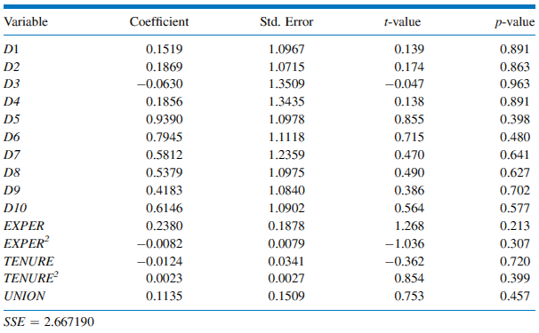

Slide 18
Fixed Effects estimator
Take the data on individual i:
Average the y and x variables across time:

Slide 19
Fixed Effects estimator
Using the fact that the parameters do not change over time, we can simplify this as:

Slide 20
Fixed Effects estimator

Slide 21
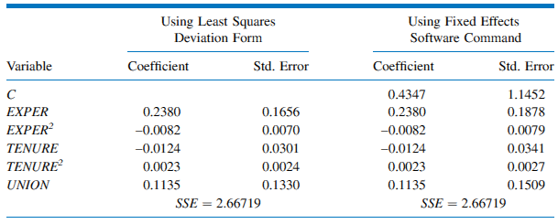

Slide 22
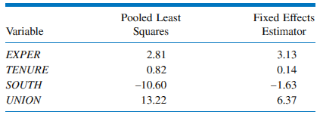
How much did unobserved heterogeneity matter?

Slide 23
Random effects model
Individual differences are assumed to be random deviations from the mean and can be included in our model by specifying the intercept to consist of a fixed part that represents the population average and random individual differences from the population average:
The random individual differences u_{i} are called random effects and have:

Slide 24
Random effects

Slide 25
The combined error term is:
The random effects error has two components:
One for the individual deviations from the average
One for the regression error
The random effects model is often called an error components model

Slide 26
Which is better– fixed or random effects?
Fixed effects model
No problem of correlation.
Easy to estimate.
BUT
Many parameters and loss of degrees of freedom.
Cannot estimate the effect of time invariant variables such as gender, race, education etc.
Random Effects model
Can estimate the effect of time invariant variables such as gender, race, education etc.
No loss of degrees of freedom.
BUT
Problem of correlation between u_{i} and X variables.

Slide 27
SAS Code
;
PROC PANEL
proc panel data=a;
id CS_ID TS_ID;
model y = x1 x2/ fixone ranone fixtwo rantwo;
run;
FIXONE - One way fixed effects – cross section (CS) heterogeneity
FIXTWO - Two way fixed effects – CS + TS heterogeneity
RANONE - One way random effects (CS het)
RANTWO – Two way random effects (CS + TS het)

Slide 28
OUTPUT
COST
Estimation Method | RanTwo
Number of Cross Sections | 6
Time Series Length | 4
Fit Statistics
SSE | 0.3481 |  | DFE |  | 22
MSE | 0.0158 |  | Root MSE |  | 0.1258
R-Square | 0.8136
Variance Component Estimates
Variance Component for Cross Sections |  | 0.046907
Variance Component for Time Series |  | 0.00906
Variance Component for Error |  | 0.008749
Variance for CS is much larger than that for TS

Slide 29
Hausman Test for Random Effects
DF | m Value | Pr > m
1 | 26.46 | <.0001
If Hausman test rejects Null hypotheses of no correlation between error term u_{i} and X variables,
then use Fixed Effects model.

Slide 30
Parameter Estimates
Variable | DF | Estimate | Standard Error | t Value | Pr > |t|
Intercept | 1 | -2.99992 | 0.6478 | -4.63 | 0.0001
output | 1 | 0.746596 | 0.0762 | 9.80 | <.0001

